Slide 1
PROJECT PICTURES PORTFOLIO
Executed & Ongoing Projects by Lucid Technical Investments Co.

Slide 2
PROJECT NAME: STANDARD CHARTERED BANK LOCATION: FAISALIYAH TOWER 16TH FLOOR -RIYADH CLIENT: INC GROUP CONSULTANT: ACCOLADE ENGINEERING
Scope Executed:
COMPLETE FITOUS
FLOOR FINISHES
CEILING FINISHES
WALL FINISHES
DOORS AND GLAZED GLASS PARTIONS
MEP AND CIVIL SCOPE
MEP WORKS TURNKEY SOLUTION

Slide 3
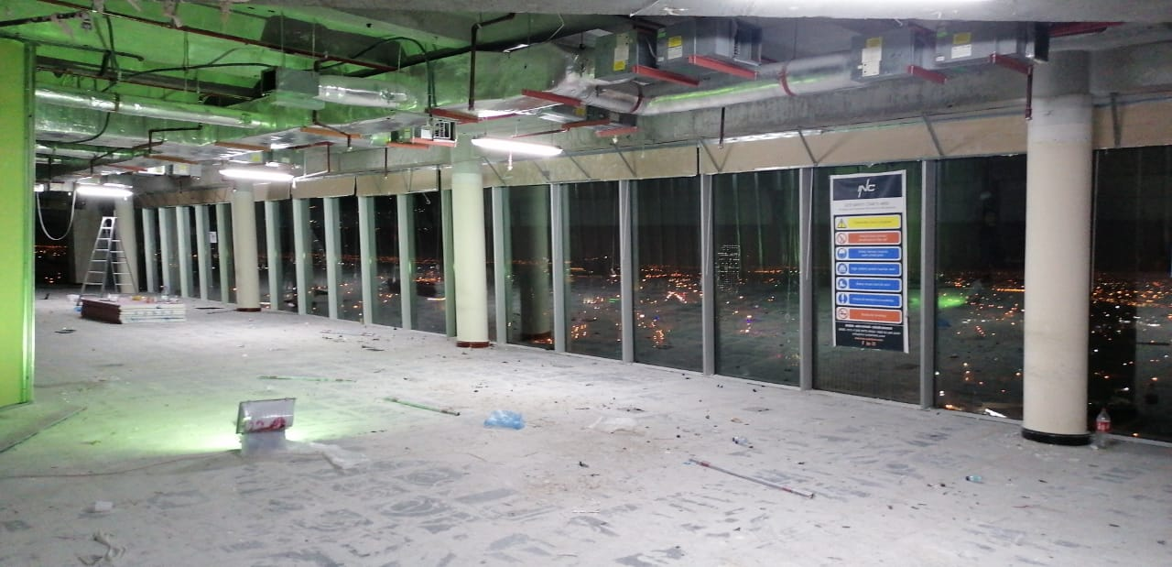
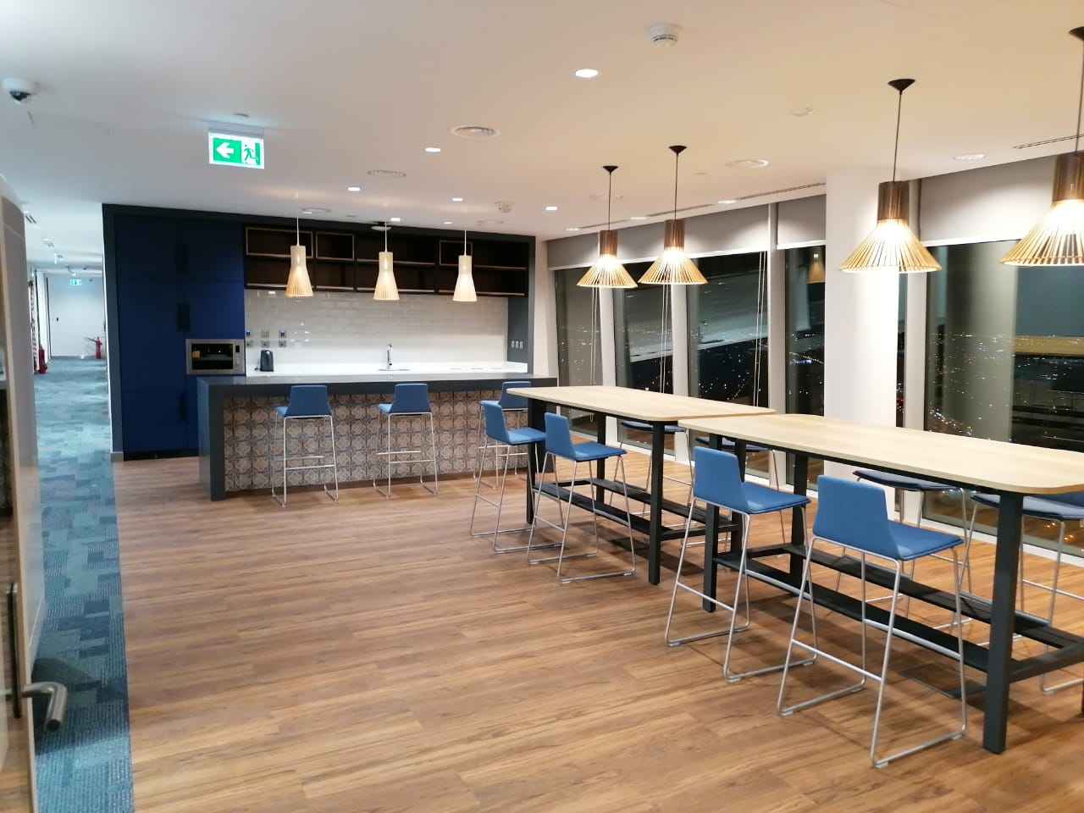
BEFORE
AFTER

Slide 4
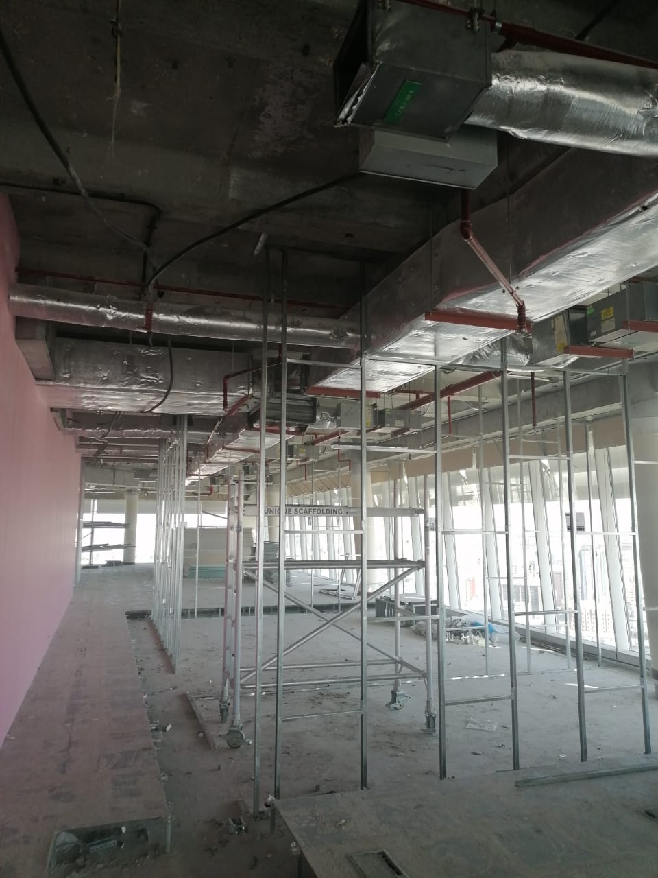
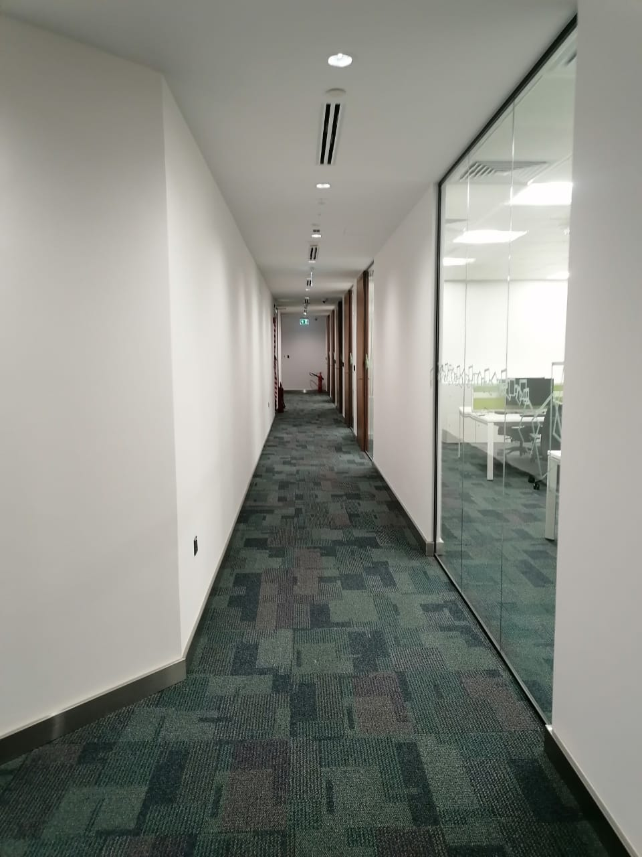
BEFORE
AFTER

Slide 5
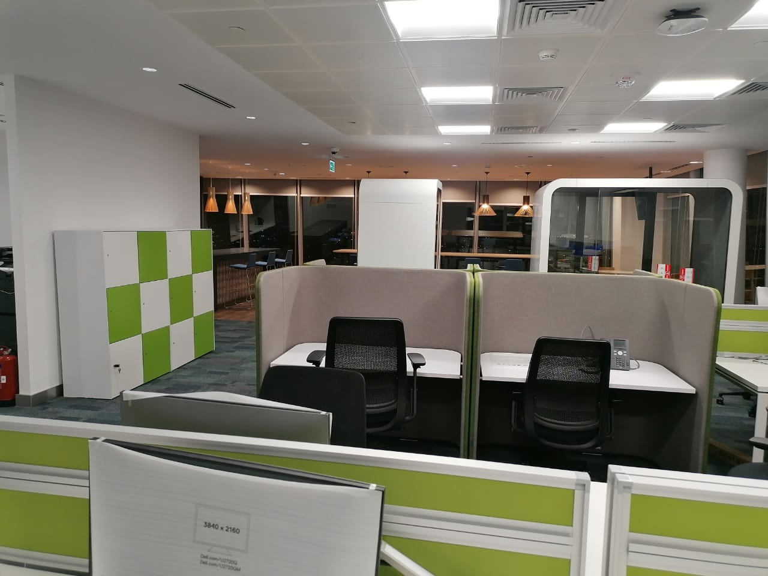
BEFORE
AFTER

Slide 6
PROJECT NAME: RENOVATION WORKS LOCATION: RIYADH CLIENT: COGNIZANT.
Scope Executed:
COMPLETE FITOUS
FLOOR FINISHES
CEILING FINISHES
WALL FINISHES
DOORS AND GLAZED GLASS PARTIONS
MEP AND CIVIL SCOPE

Slide 7
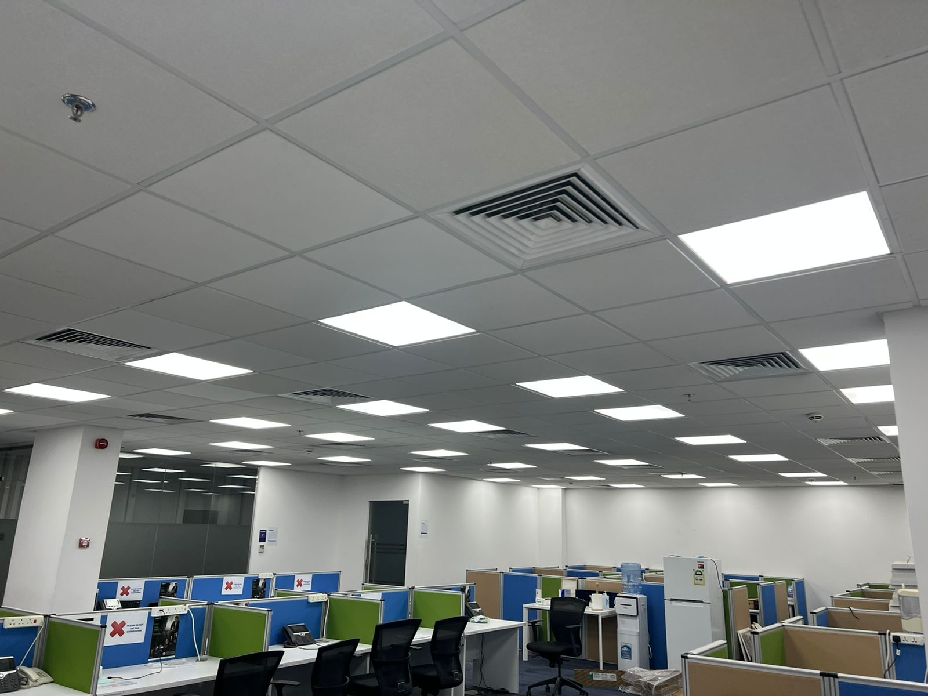
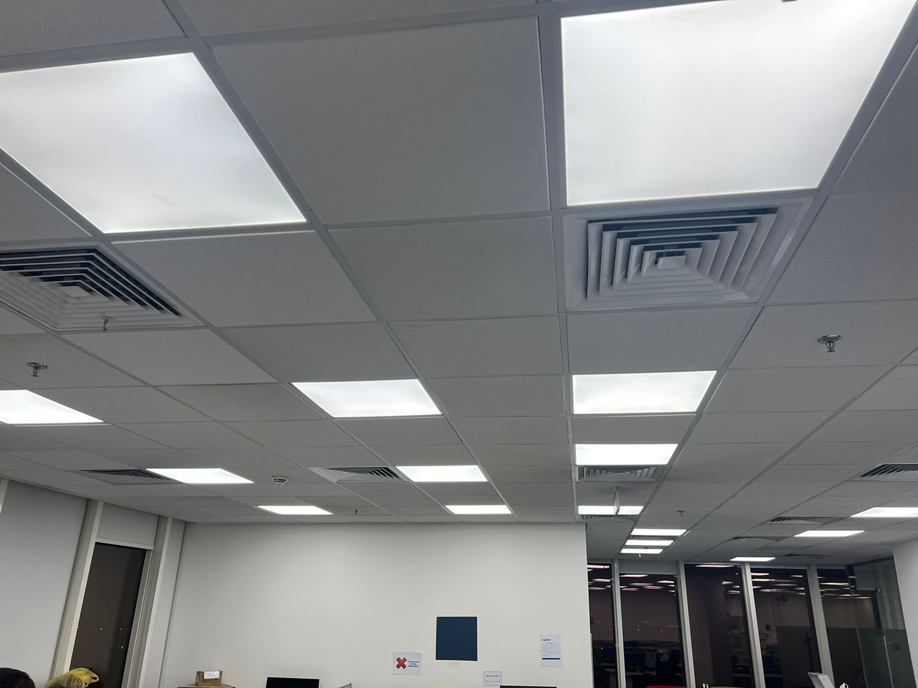

Slide 8
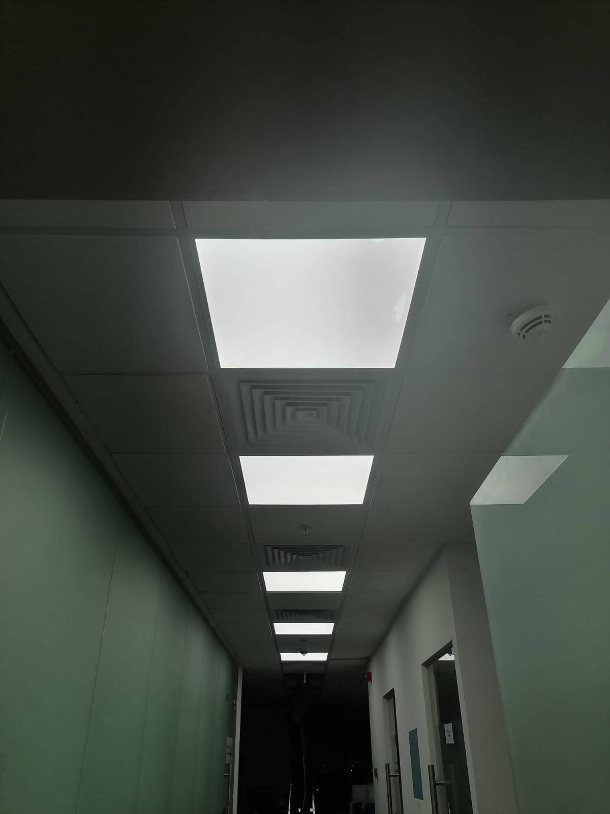
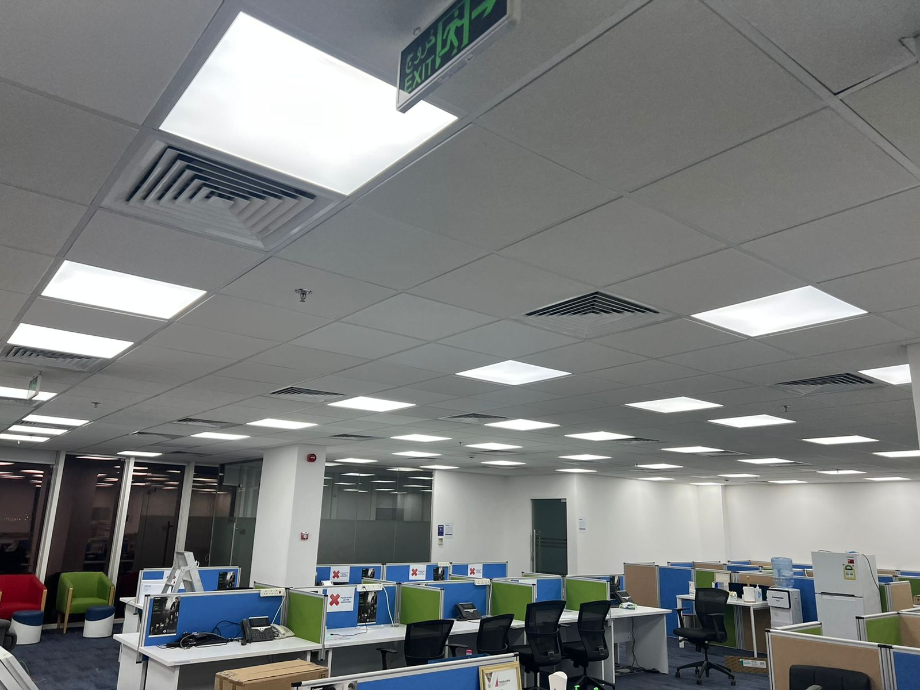

Slide 9
PROJECT NAME: RENOVATION WORKS @ DKNY SHOWROOMS LOCATION: RIYADH CLIENT: DKNY
Scope Executed:
RENOVATION FITOUS
FLOOR FINISHES
CEILING FINISHES
WALL FINISHES
FURNITURE FINISHES
MEP AND CIVIL SCOPE

Slide 10
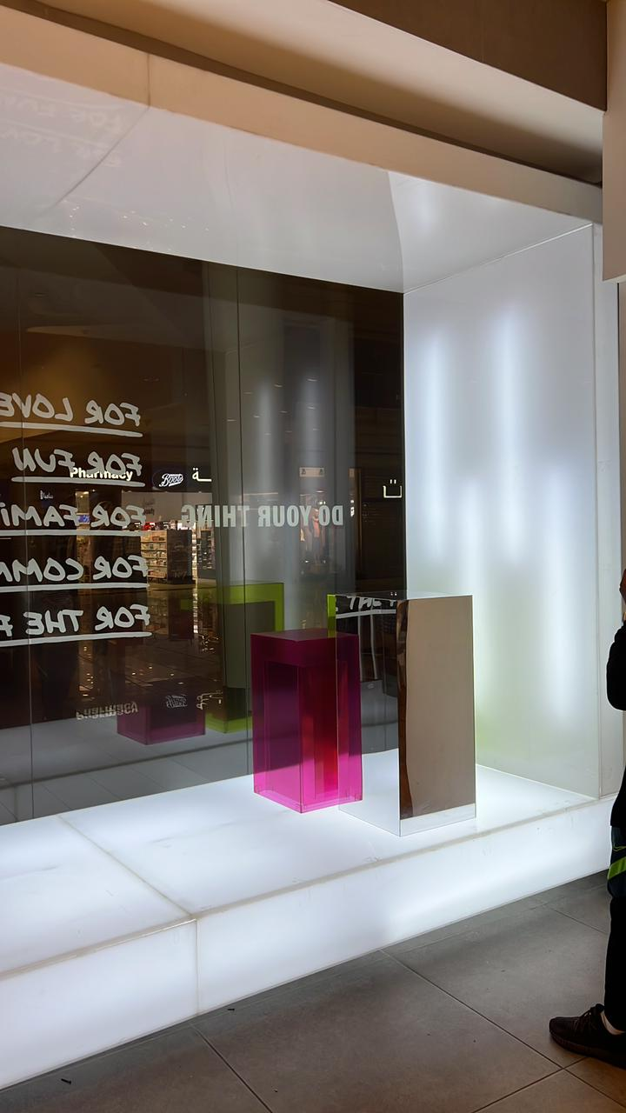
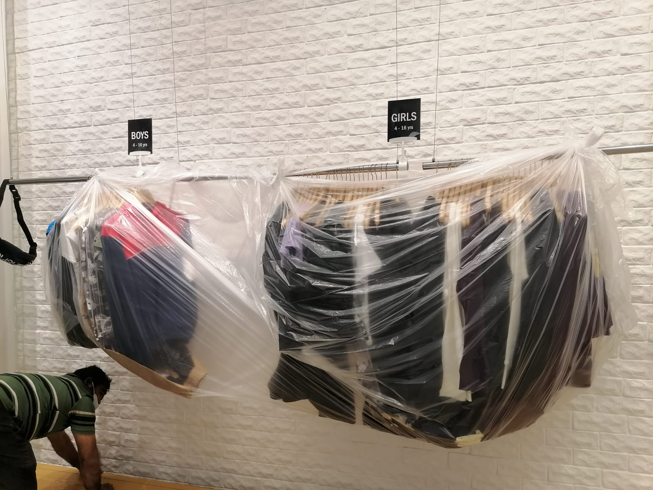

Slide 11
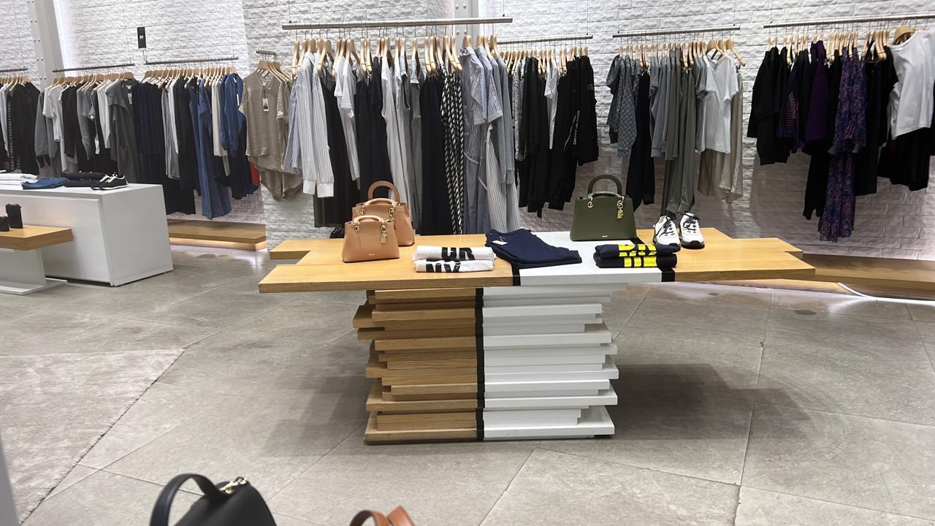
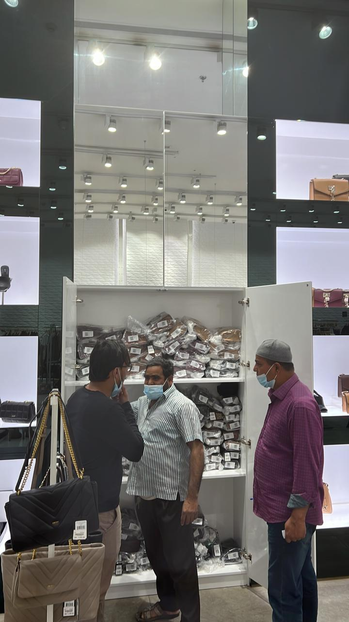

Slide 12
PROJECT NAME: EMIRATES NBD BANK LOCATION: RIYADH CLIENT: SAMMAN CONST.
Scope Executed:
COMPLETE FITOUS
FLOOR FINISHES
CEILING FINISHES
WALL FINISHES
DOORS AND GLAZED GLASS PARTIONS
MEP AND CIVIL SCOPE
MEP WORKS TURNKEY SOLUTION

Slide 13
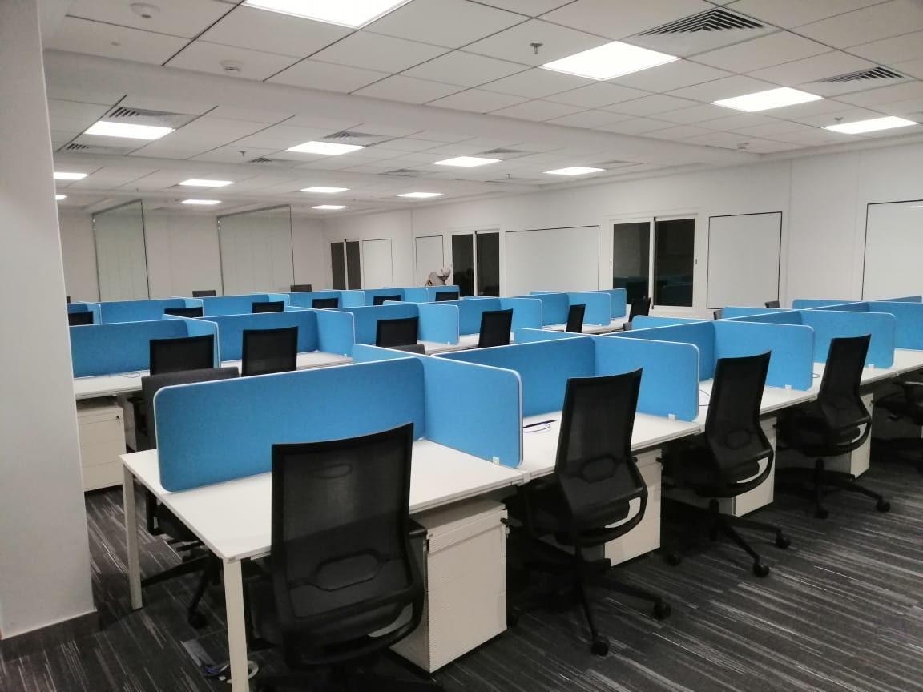
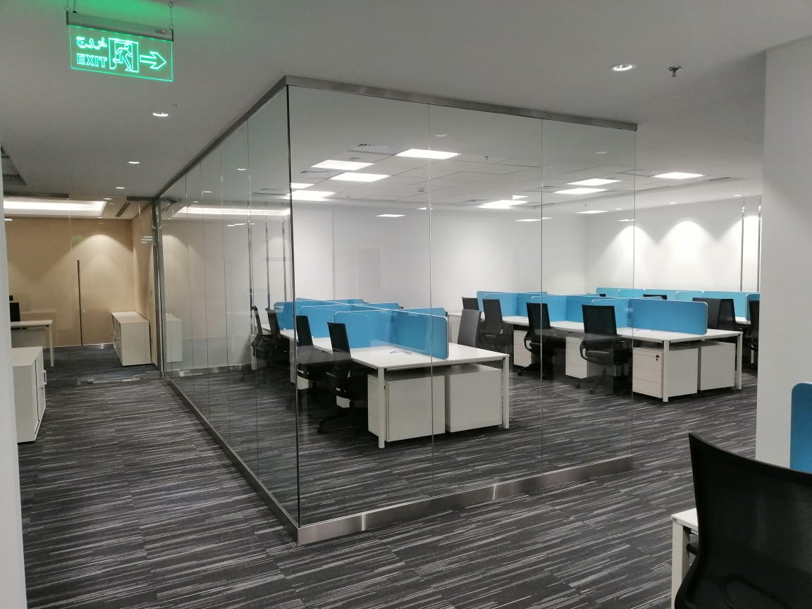

Slide 14
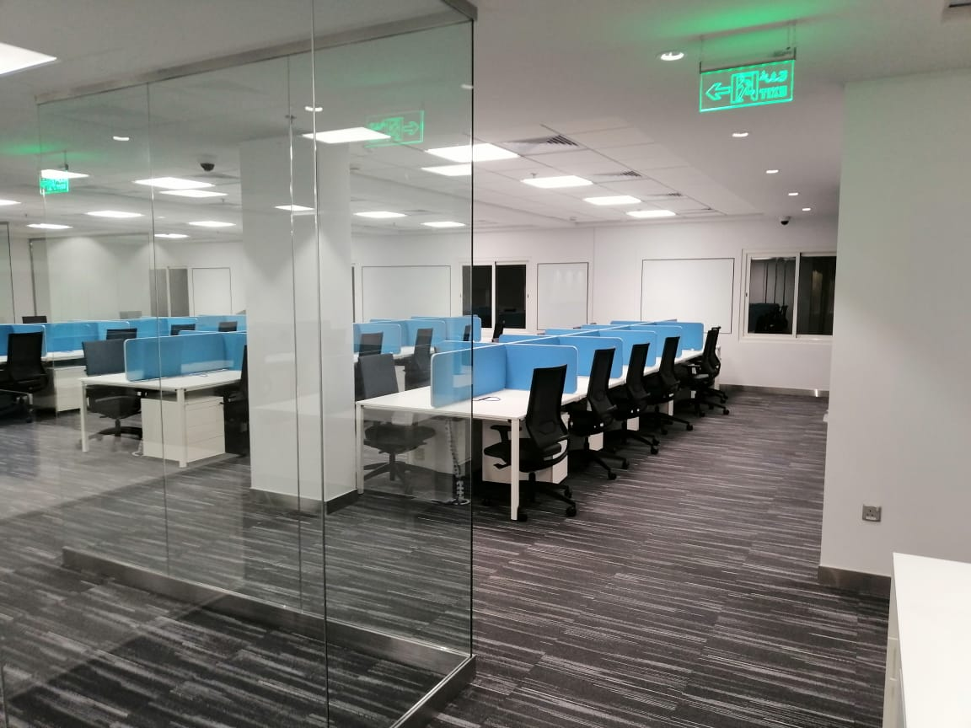
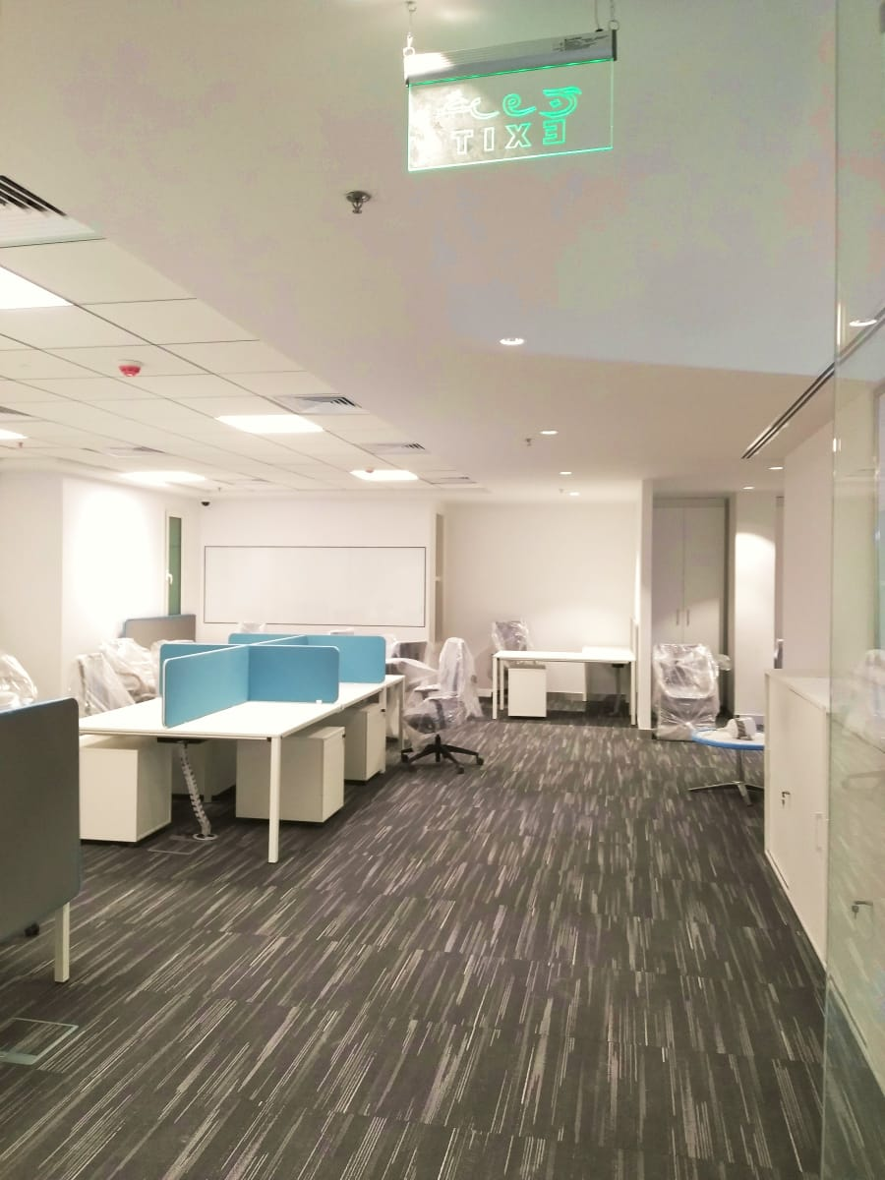

Slide 15
ON GOING PROJECT PROJECT NAME: PRINCE MOHAMMED UNIVERSITY LOCATION: DHAHRAN CLIENT: PMU CONSULTANT: AL HILAL
Scope :
Complete scope of Design, Engineering and Construction of Cyber Security Room in PMU
Procurement and Installation of complete furniture and screens
Complete civil and MEP works

Slide 16
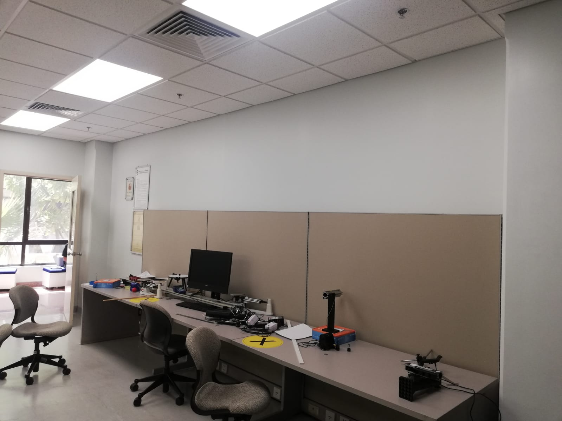
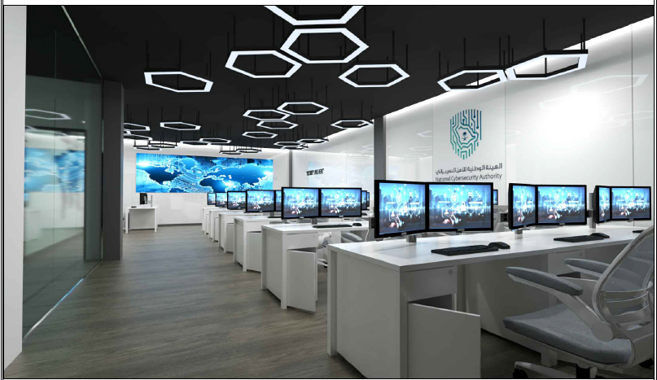
BEFORE
AFTER

Slide 17
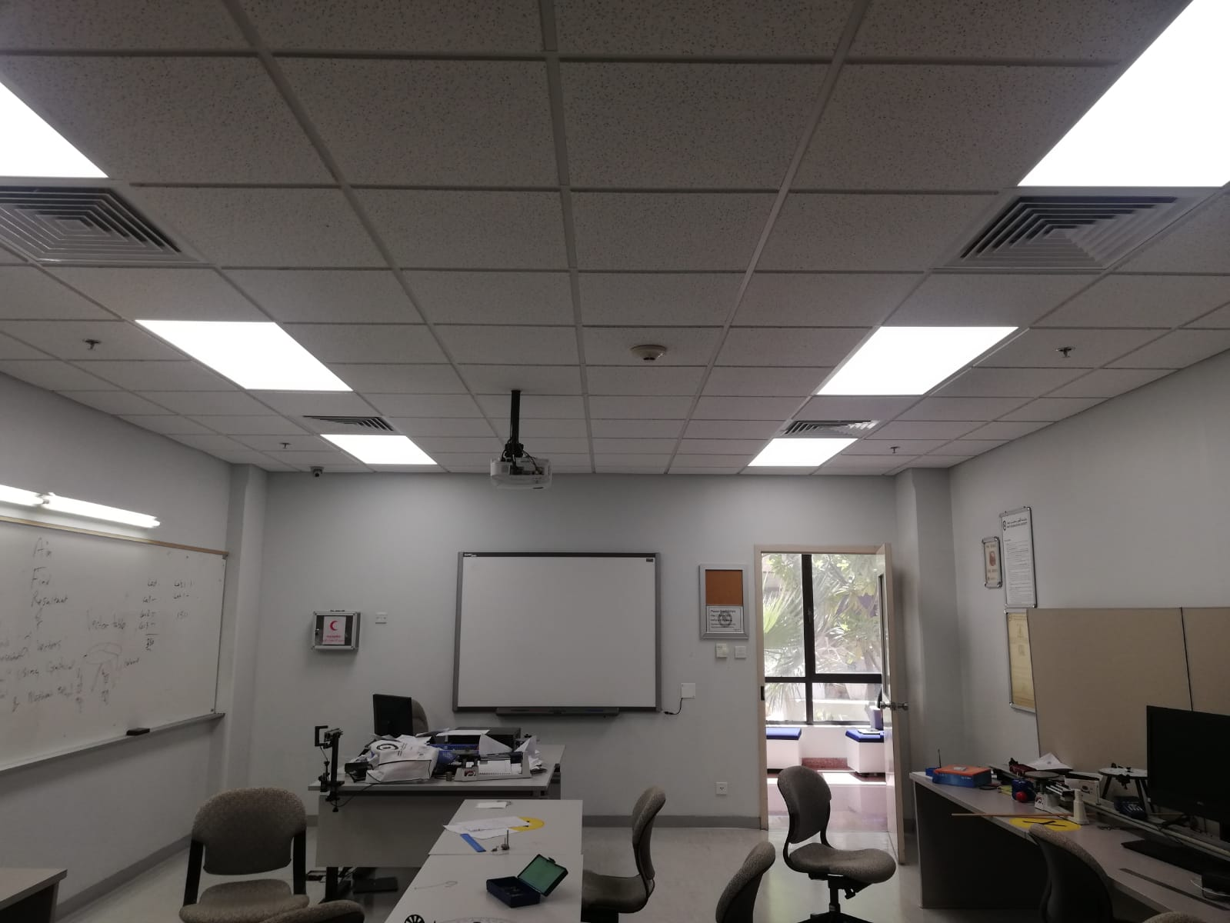
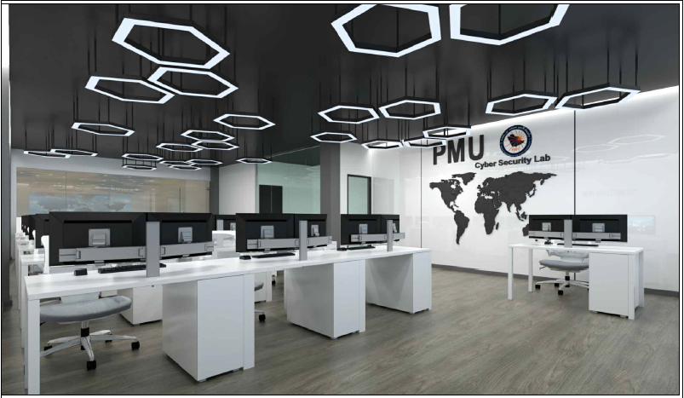
BEFORE
AFTER

Slide 18
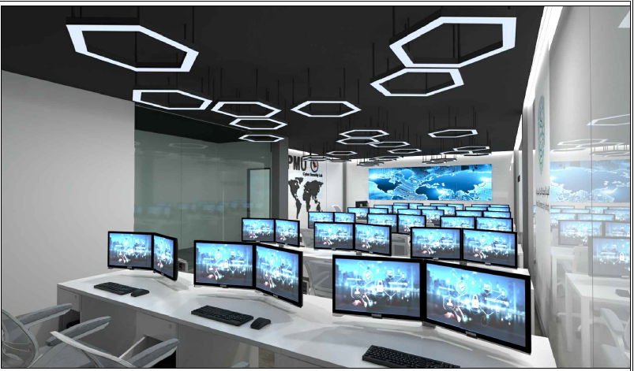

Slide 19
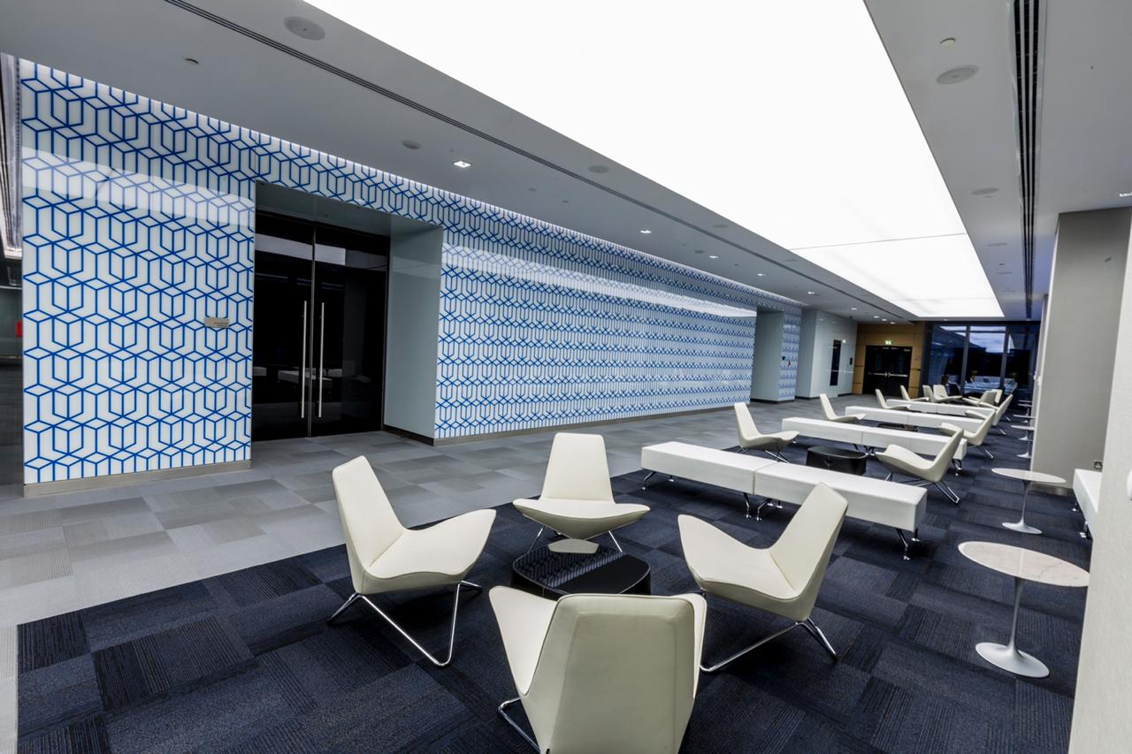
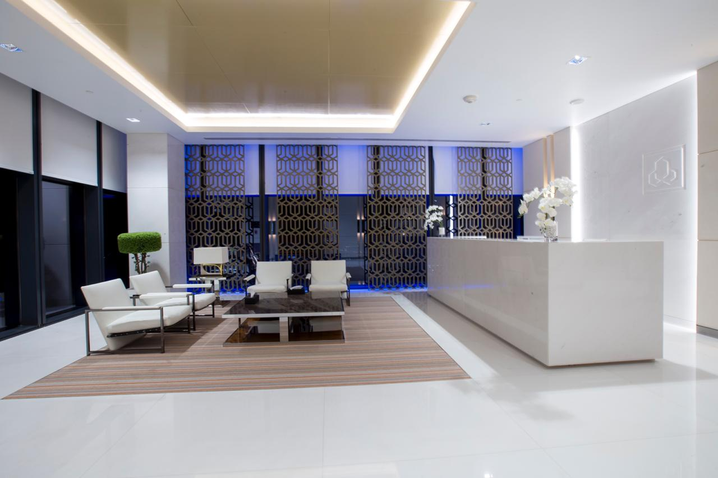

Slide 20
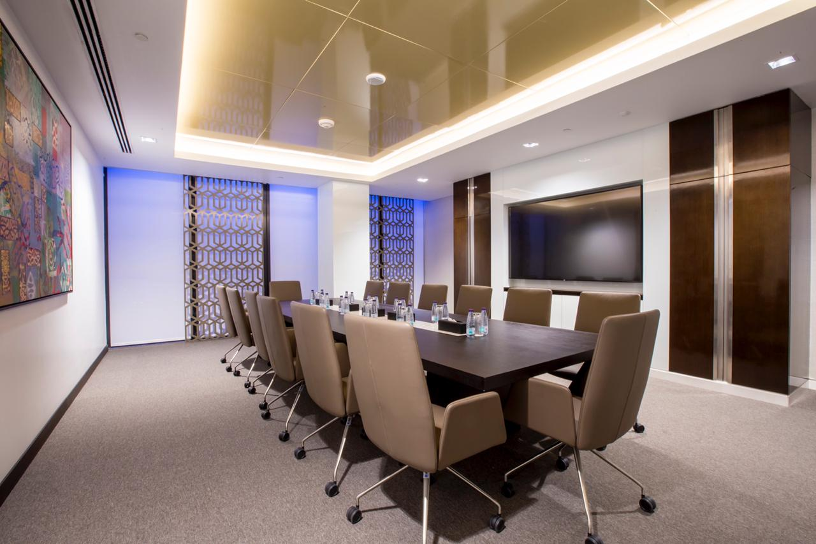
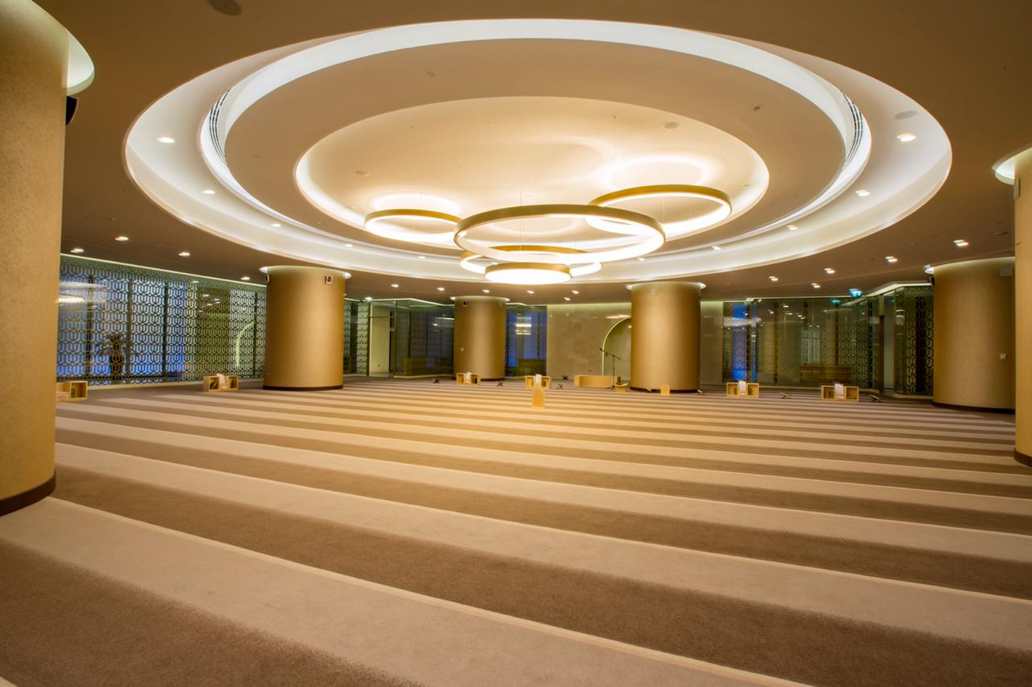

Slide 21
PROJECT NAME: ALRAJHI HEAD QUARTERS LOCATION: RIYADH CLIENT: SAMMAN CONST.
Scope Executed:
COMPLETE FITOUS
FLOOR FINISHES
CEILING FINISHES
WALL FINISHES
DOORS AND GLAZED GLASS PARTIONS
MEP AND CIVIL SCOPE
MEP WORKS TURNKEY SOLUTION

Slide 22
PROJECT NAME: GEDIA OFFICE RENOVATION LOCATION: RIYADH CLIENT: GEDIA :
Scope Executed:
OFFICE FITOUTS
FLOOR FINISHES
CEILING FINISHES
WALL FINISHES
DOORS AND GLAZED GLASS PARTIONS

Slide 24
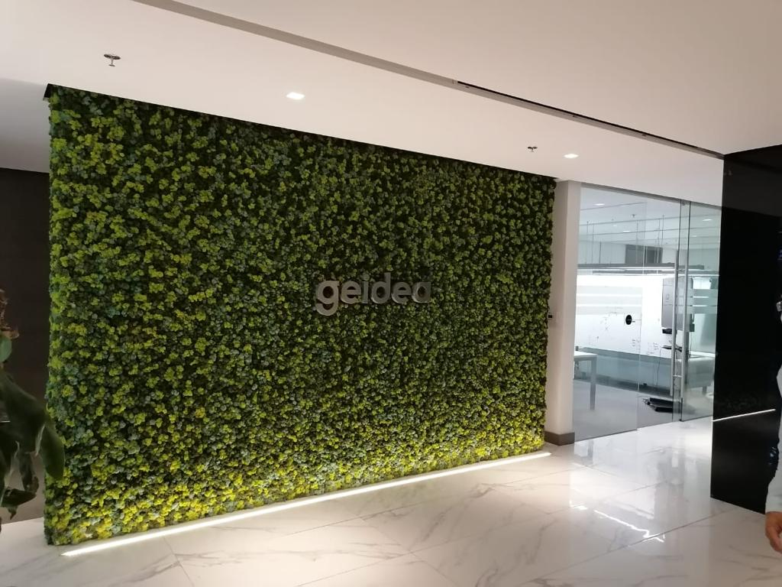
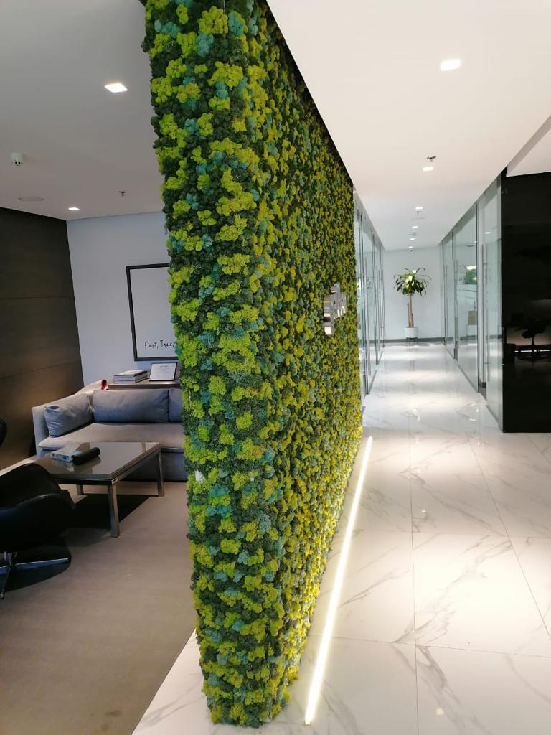

Slide 25
PROJECT NAME: MUNICIPALITY OF RURAL AFFAIRS LOCATION: RIYADH CLIENT: ENOVA BY VEOLIA CONSULTANT: TARSHID
Scope Executed:
ELECTROMECHANICAL
ELECTRICAL WORKS
MECHANICAL WORKS
LED LIGHTS REPLACMENTS

Slide 26
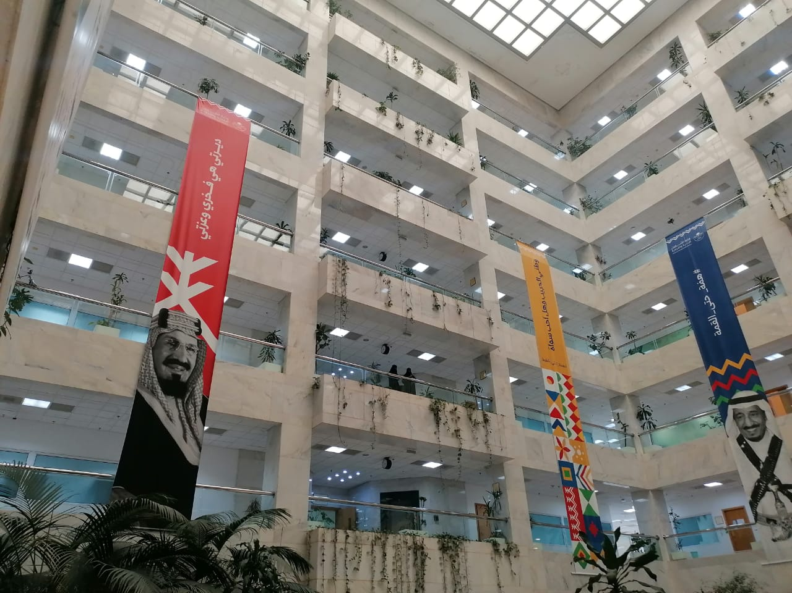
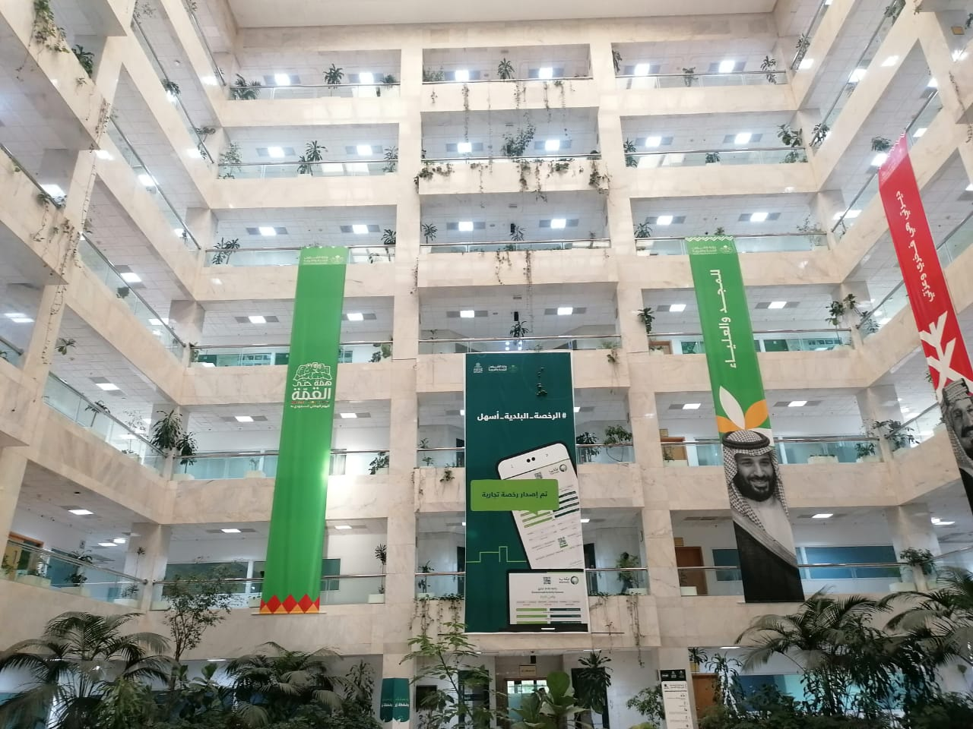

Slide 27
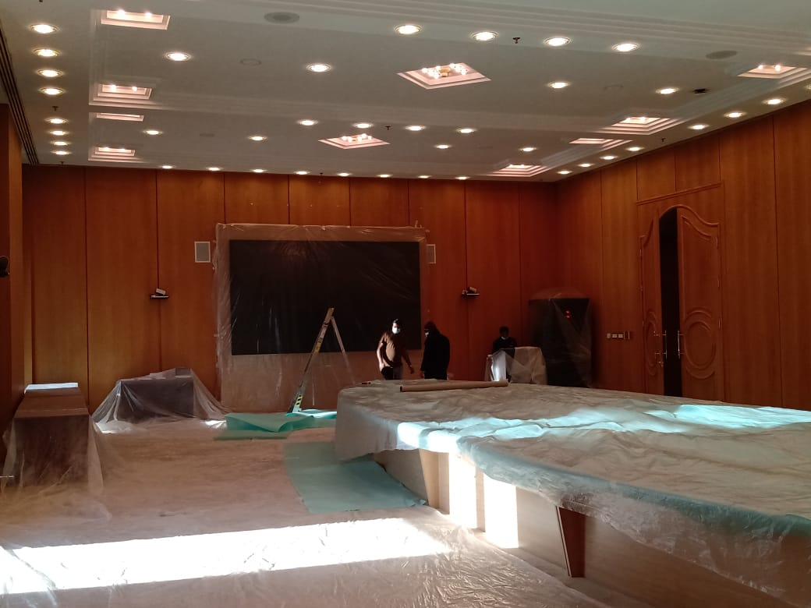
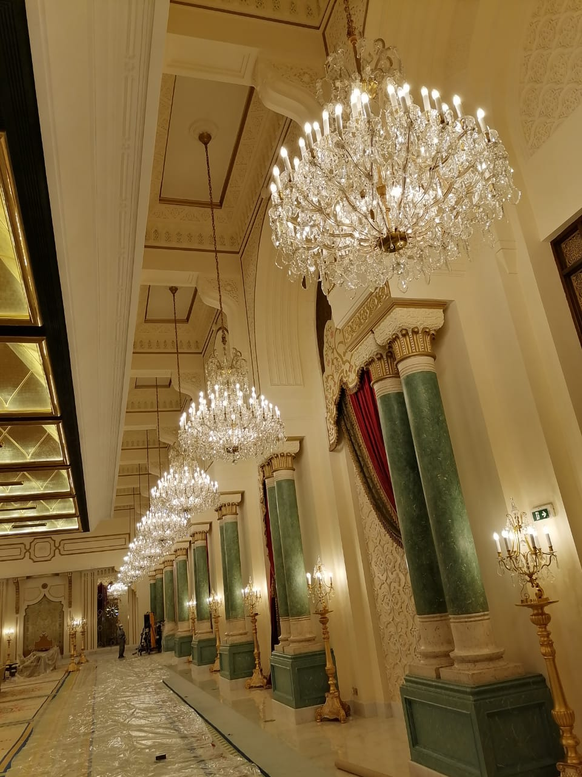

Slide 28
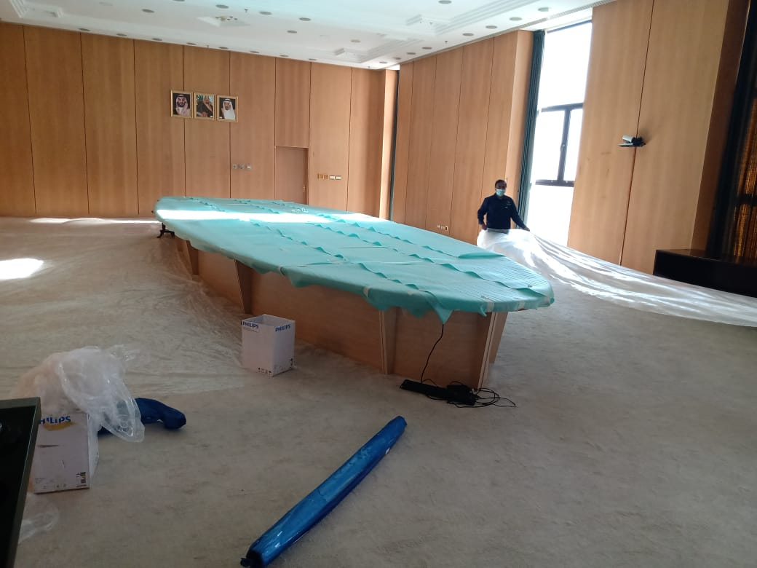
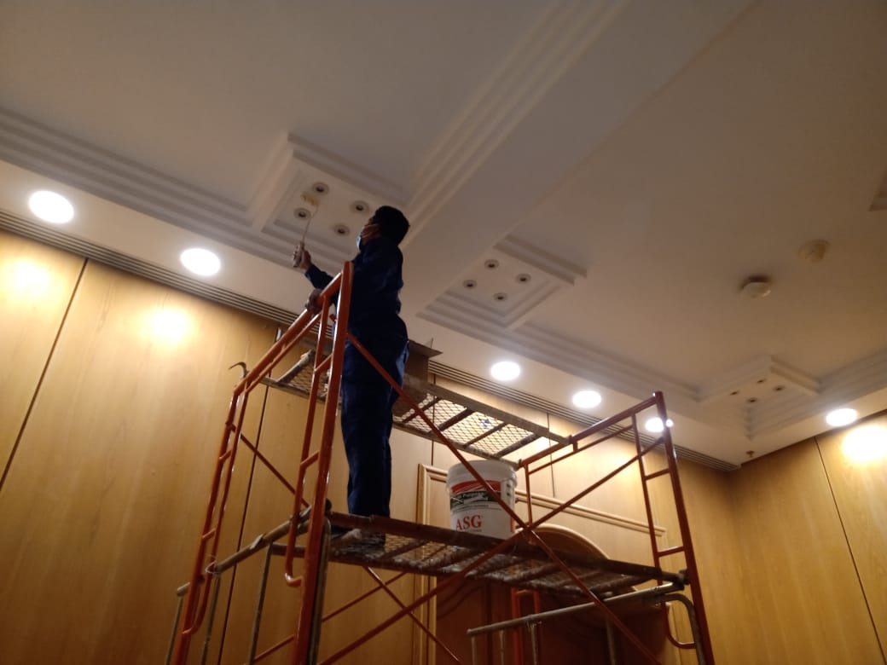

Slide 29
PROJECT NAME: MERILL LYNCH BANK OF AMERICA LOCATION: RIYADH CLIENT: ENOVA BY VEOLIA
Scope Executed:
COVID 19 PREVENTION PARTITION WORKS @ BOA

Slide 30
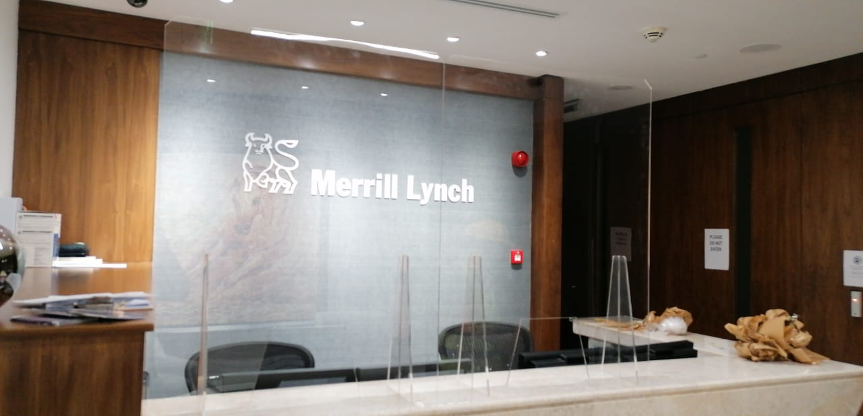
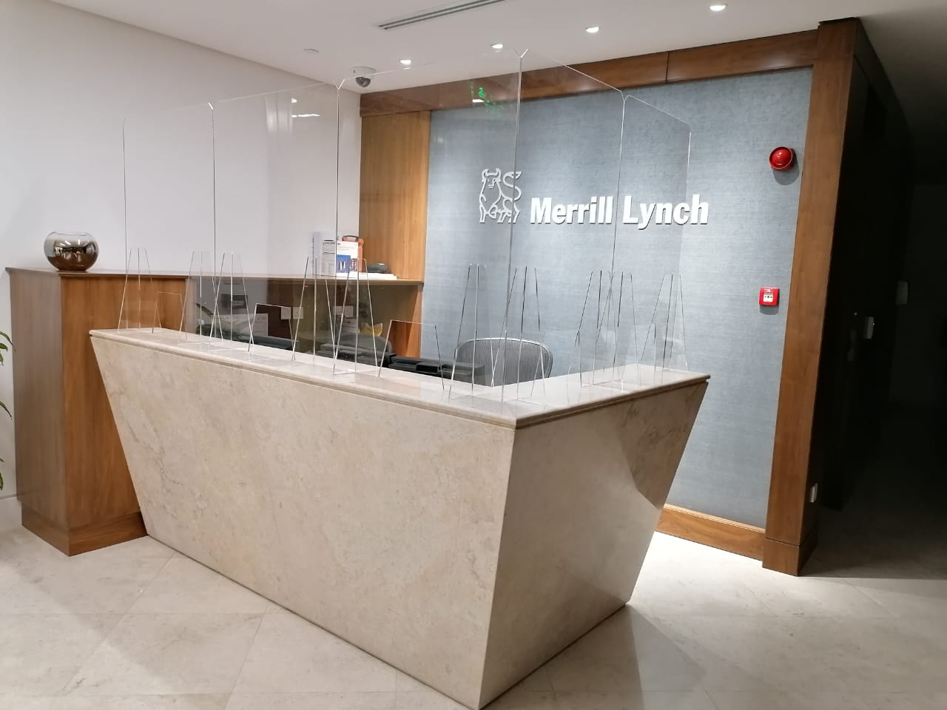

Slide 31
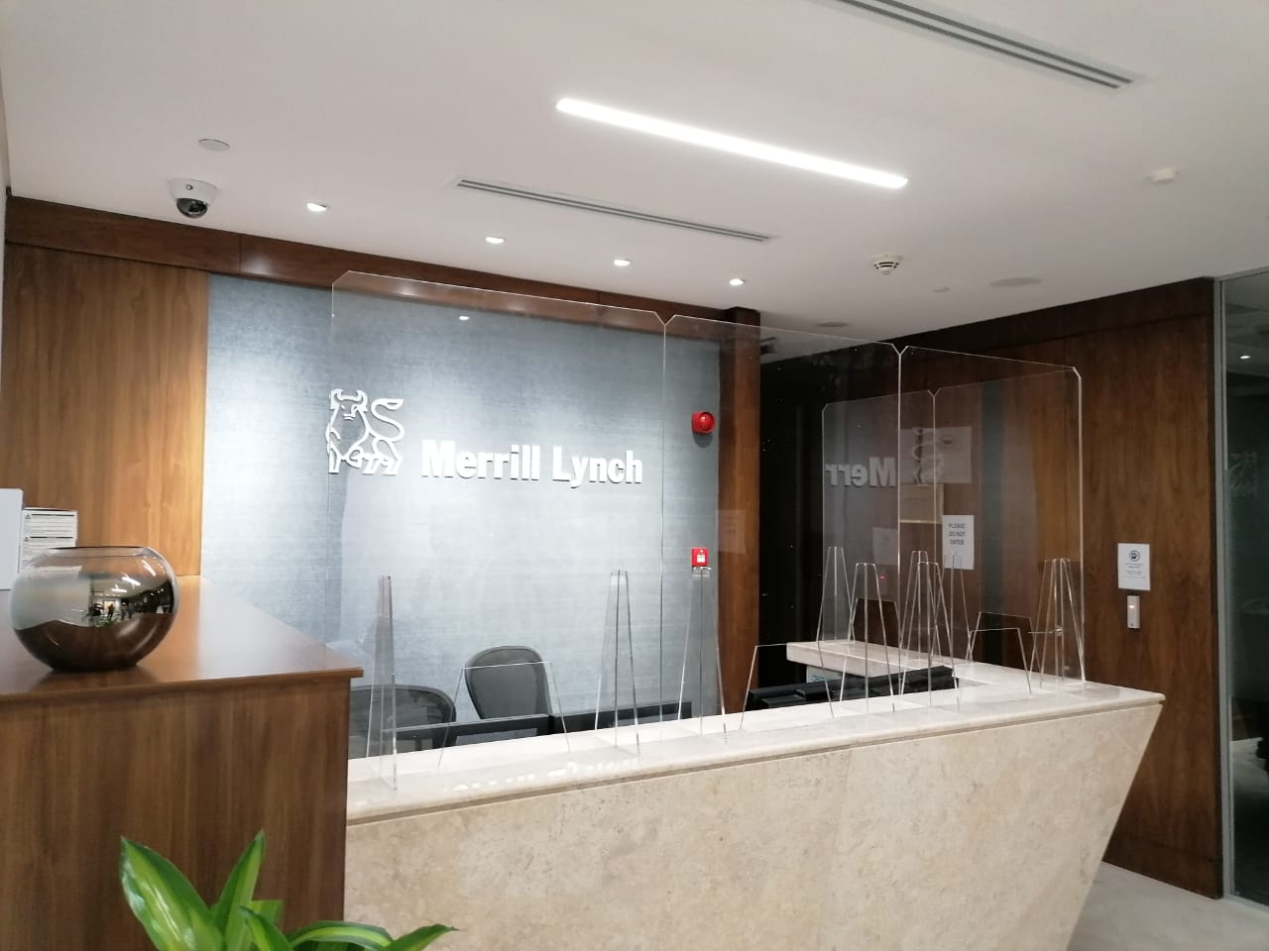
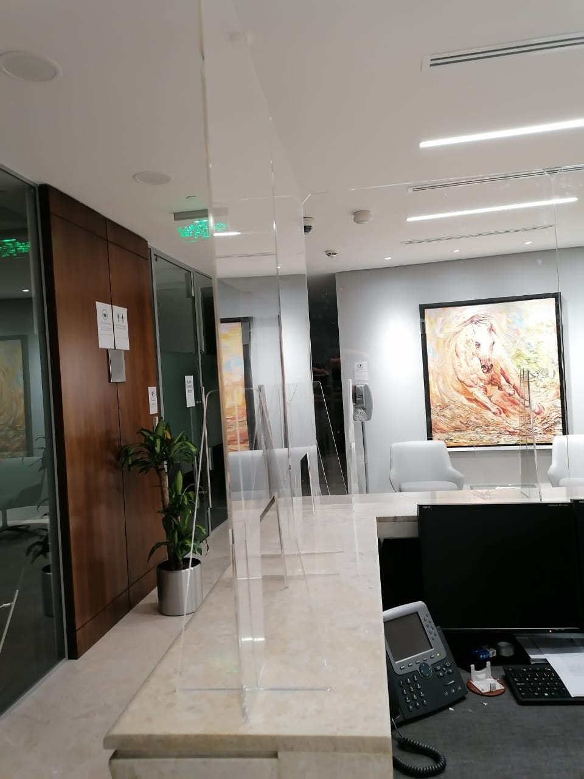

Slide 32
PROJECT NAME: HAMMADI GROUP OF HOSPITALS LOCATION: HAMMADI OLAYA CLIENT: HAMMADI
Scope Executed:
STAINLESS STEEL PARTITIONS FOR THE IV ROOMS IN HAMMADI HOSPITAL
STORAGE CABINETS

Slide 33
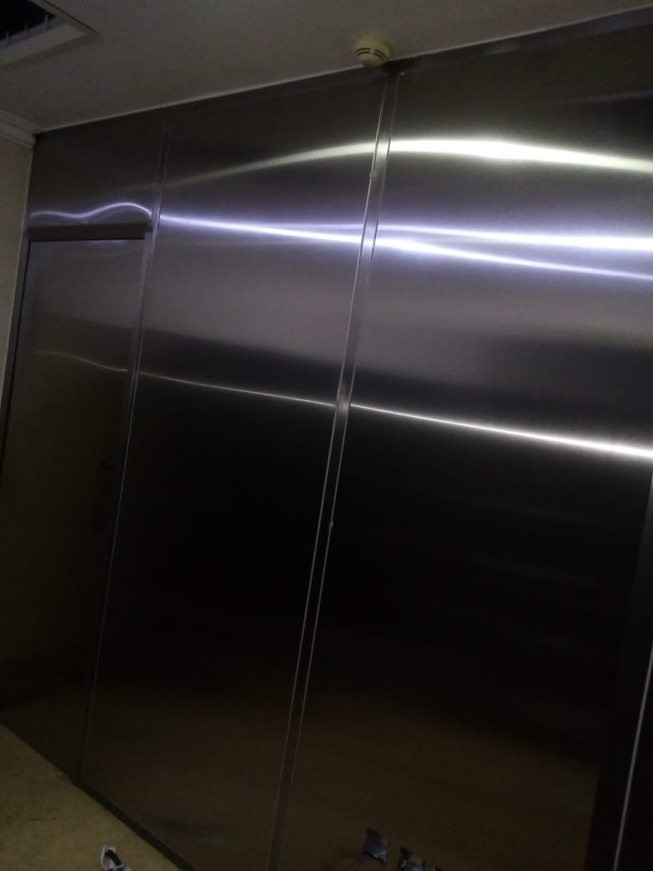
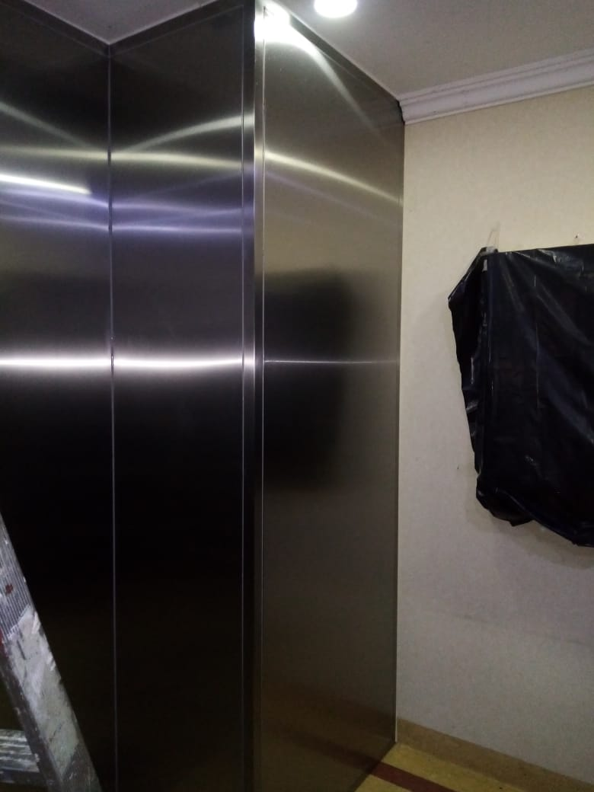

Slide 34
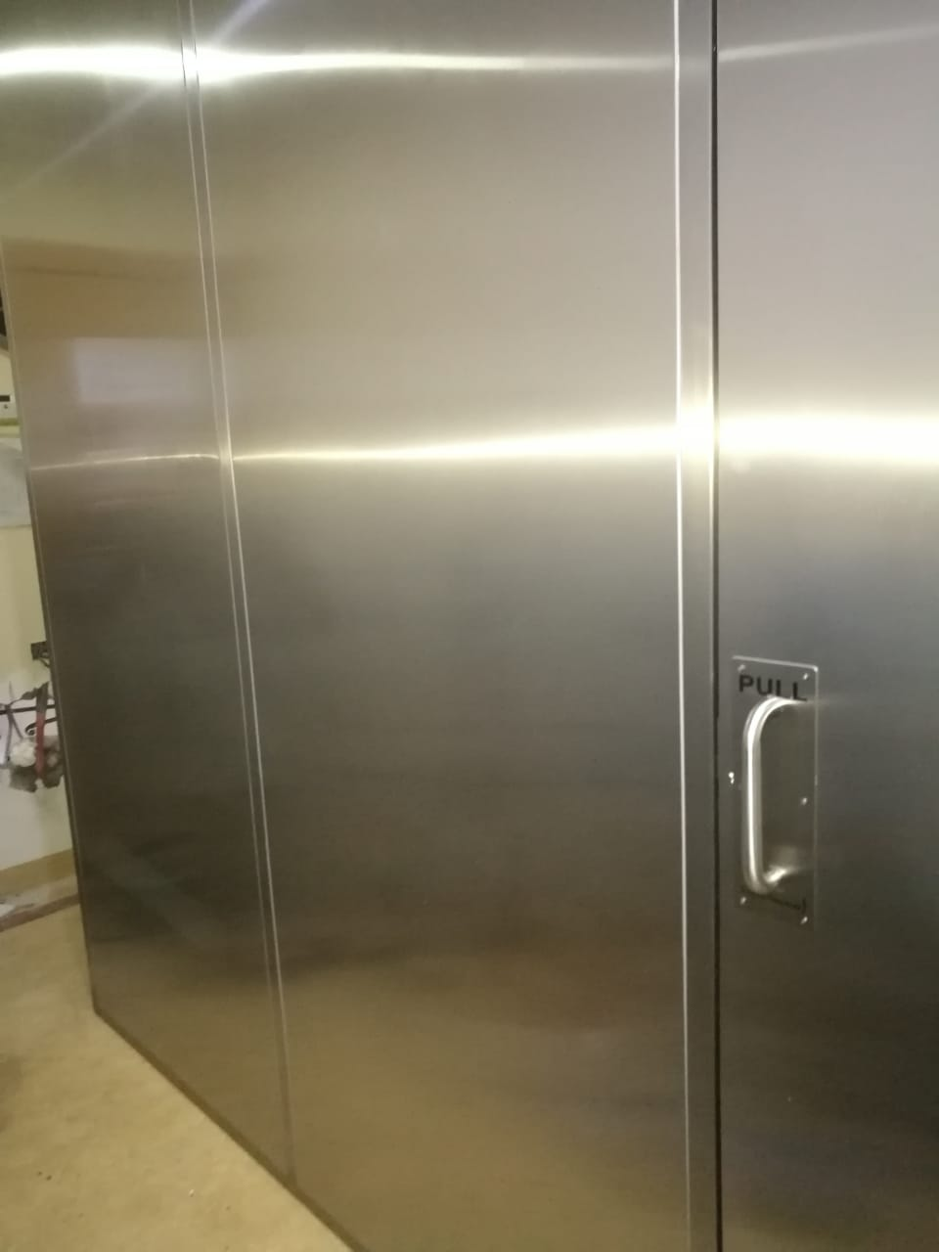
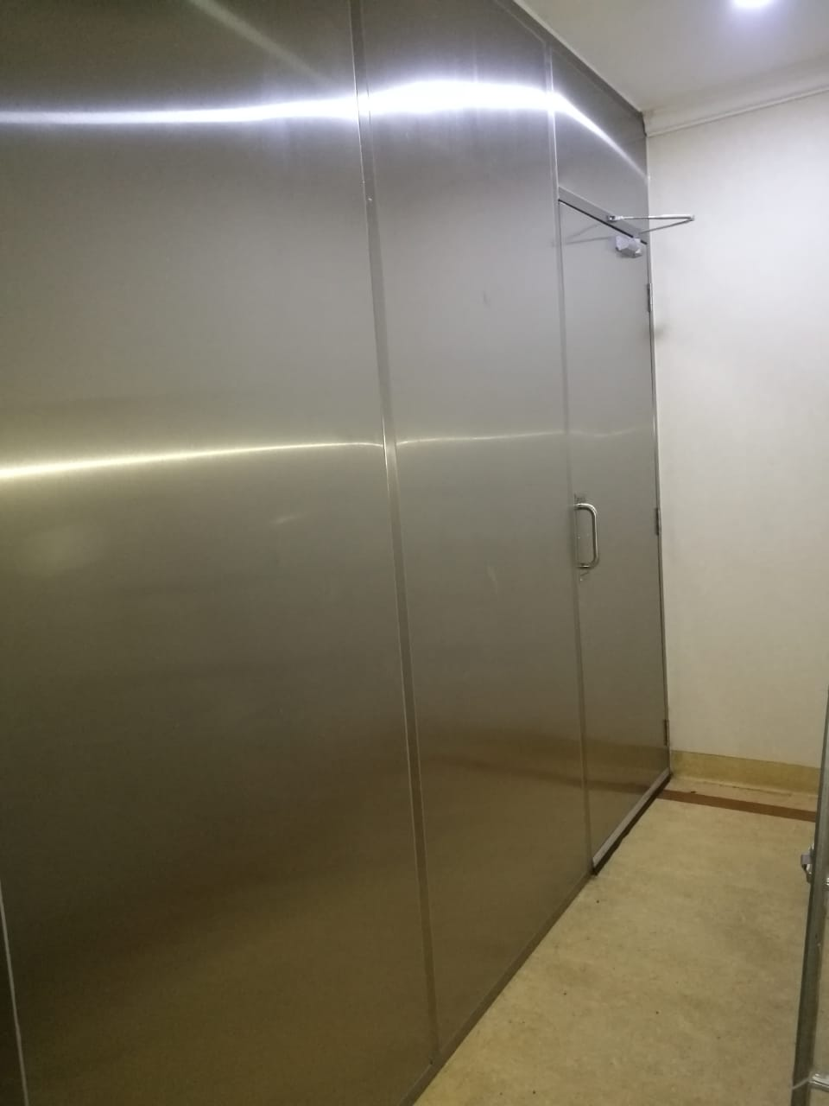

Slide 36
PROJECT NAME: ROYAL PROTOCOL LOCATION: RIYADH CLIENT: ENOVA by Veolia CONSULTANT: TARSHID (NESCO)
Scope Executed:
REPLACEMENT OF 16,000 LED FIXTURES TO PROVIDE ENERGY SAVING SOLUTION.

Slide 37
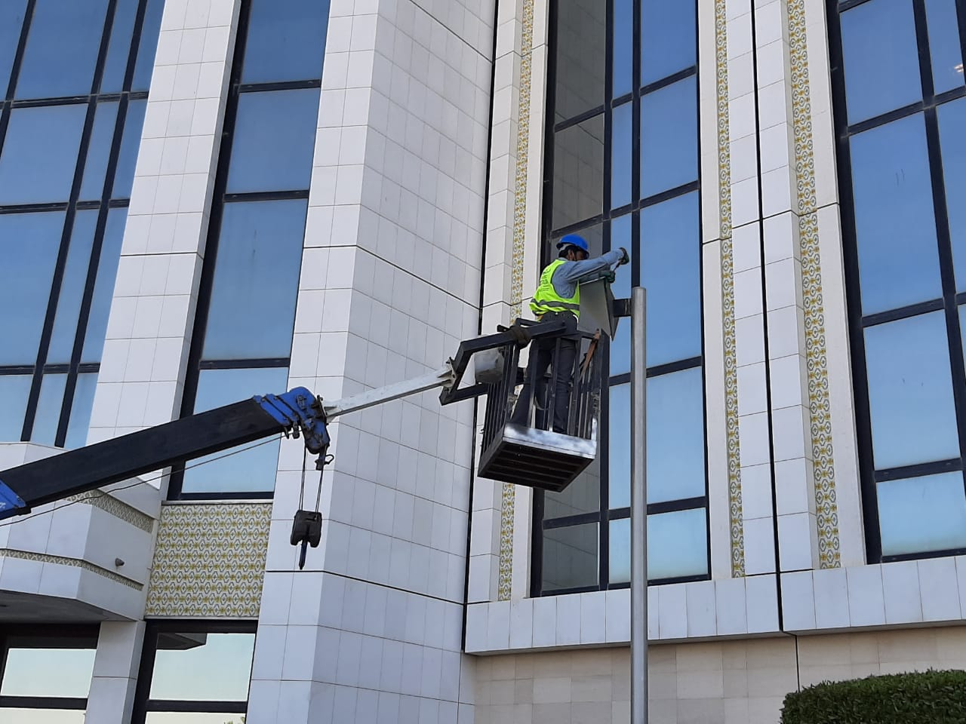
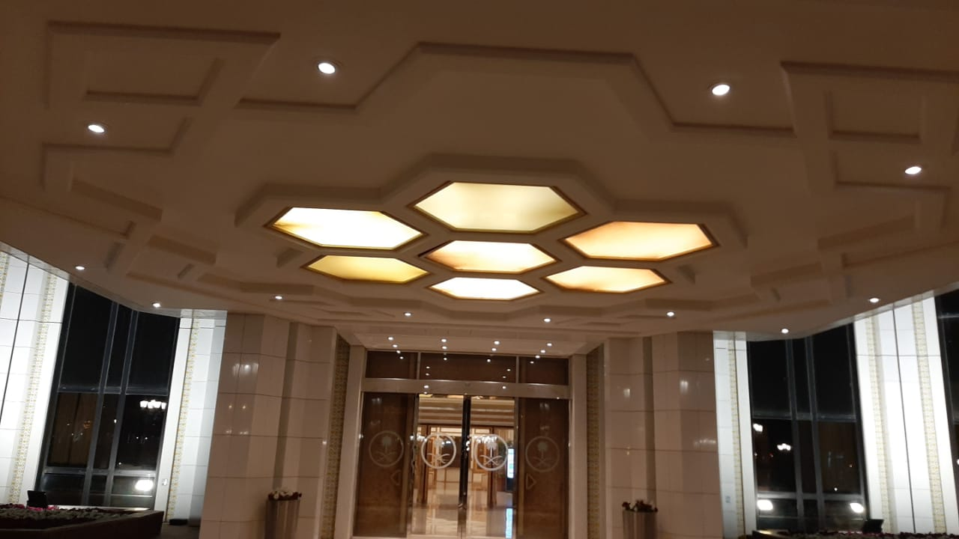

Slide 38
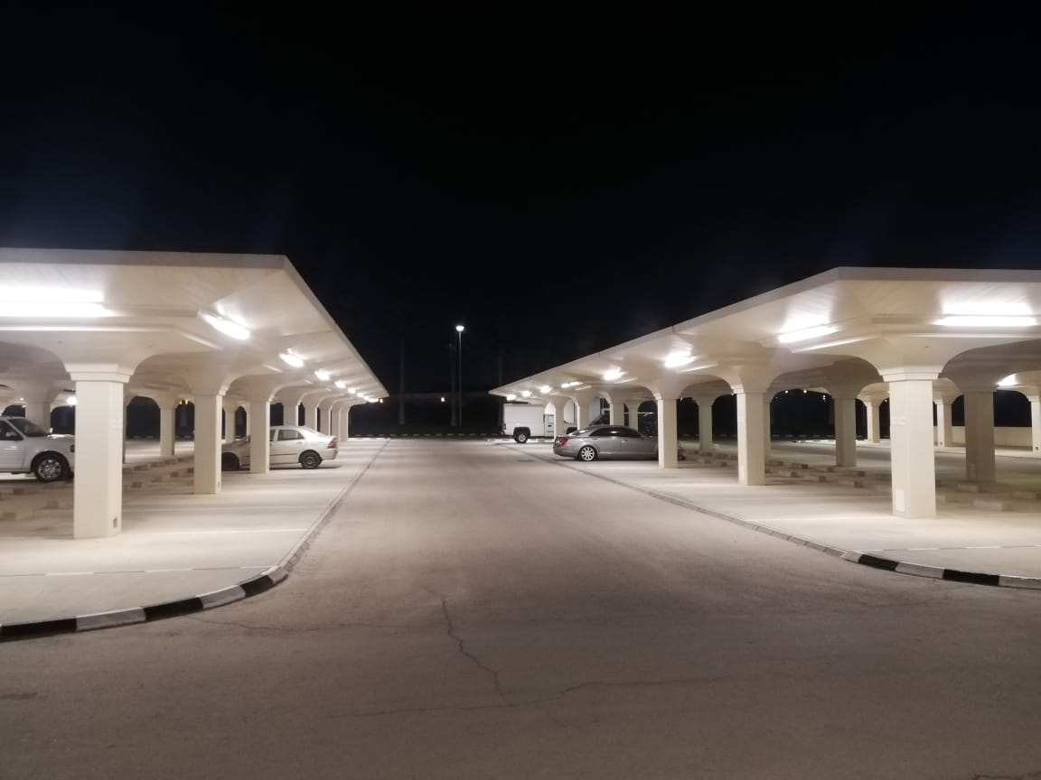
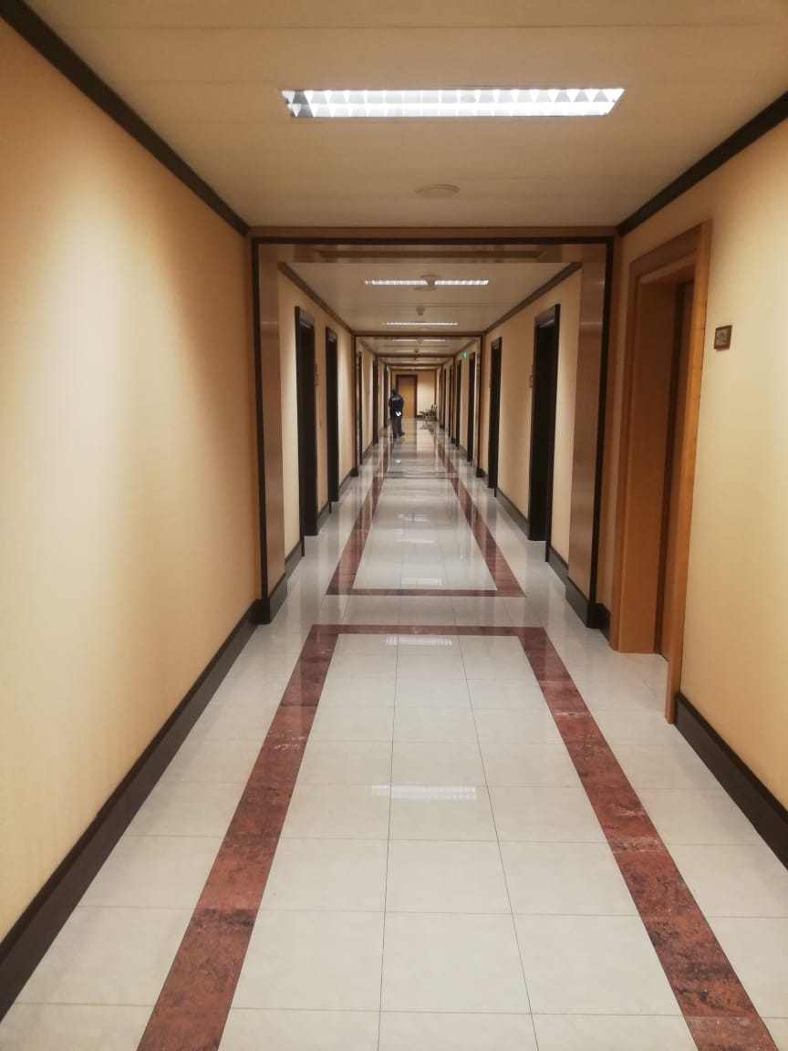

Slide 39
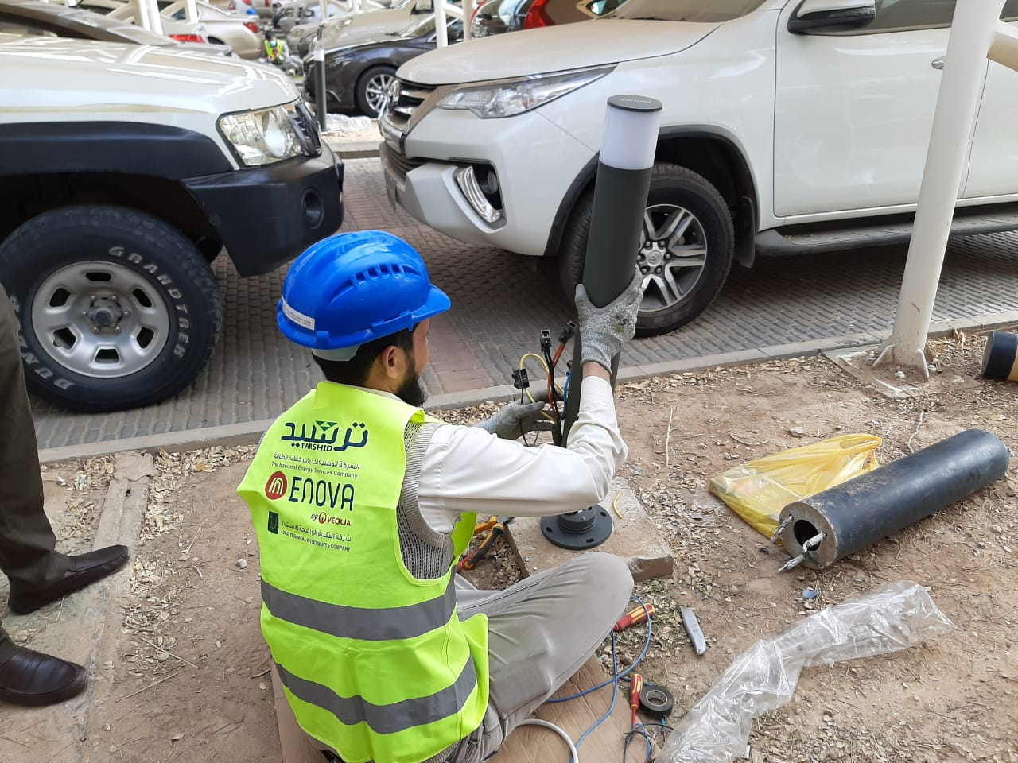
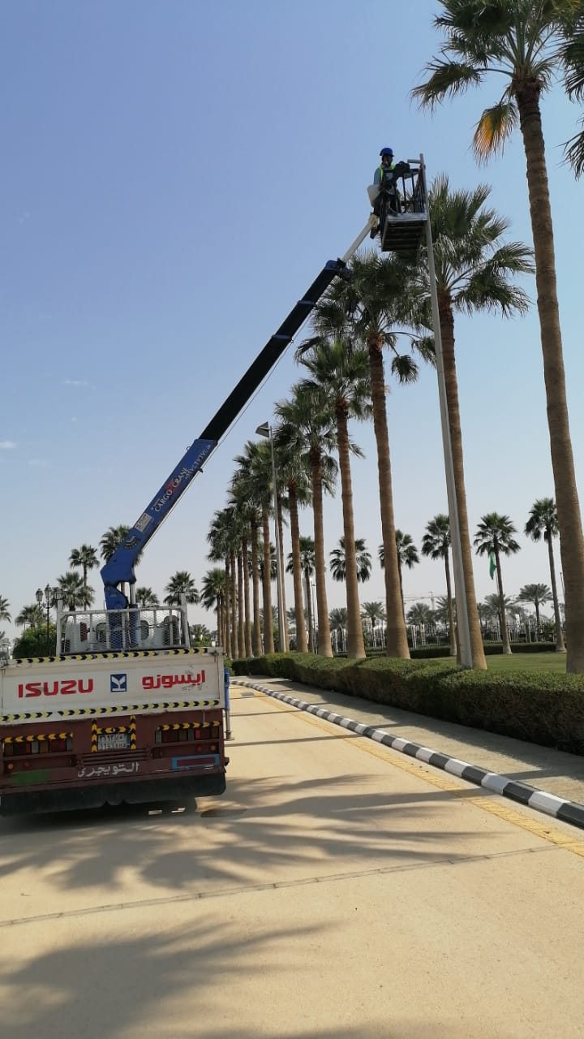

Slide 40
PROJECT NAME: KING ABDUL AZIZ MEDICAL CITY LOCATION: RIYADH CLIENT: ENOVA by Veolia CONSULTANT: TARSHID (NESCO)
Scope Executed:
REPLACEMENT OF 70,000 to 80,000 LED FIXTURES TO PROVIDE ENERGY SAVING SOLUTION.

Slide 41
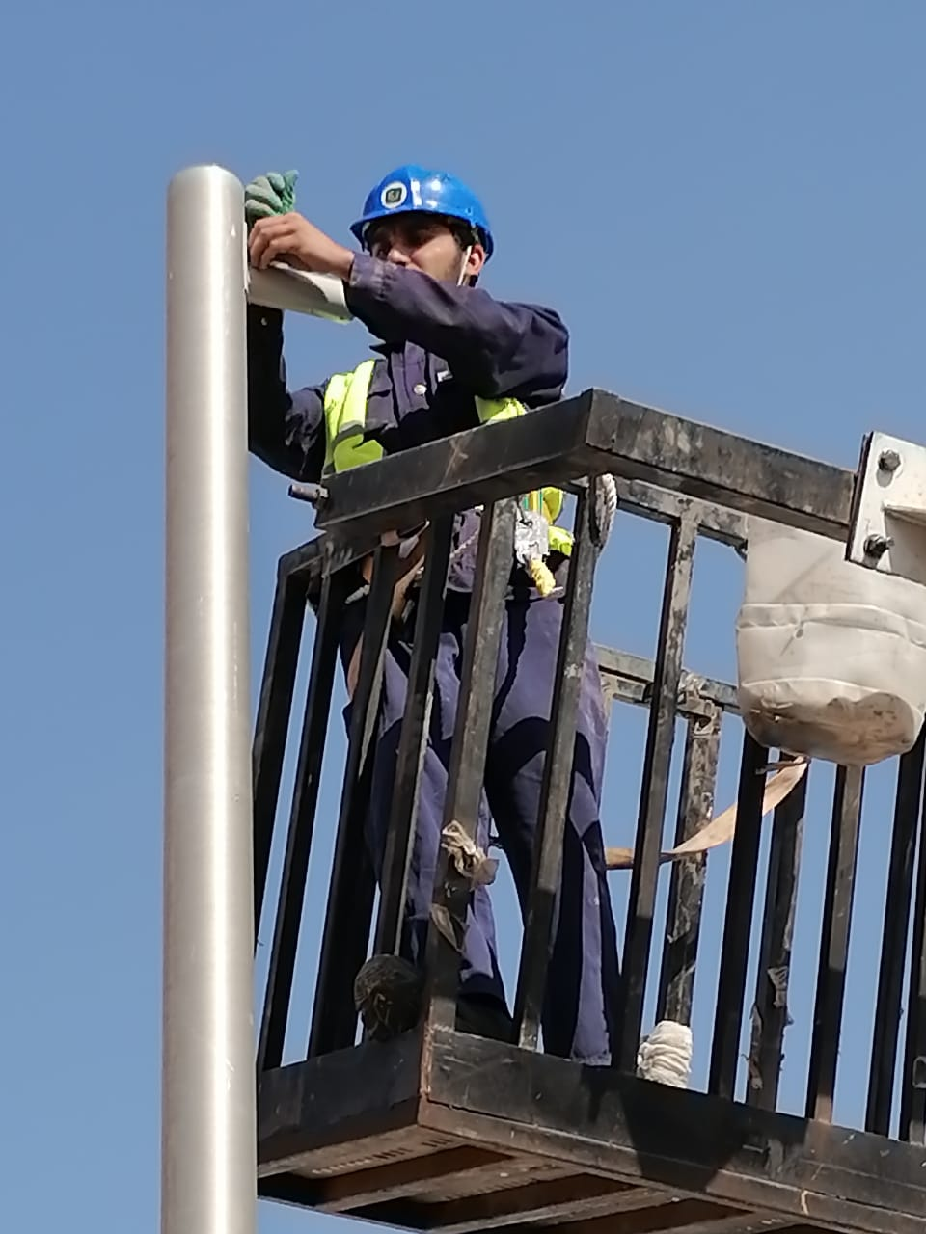
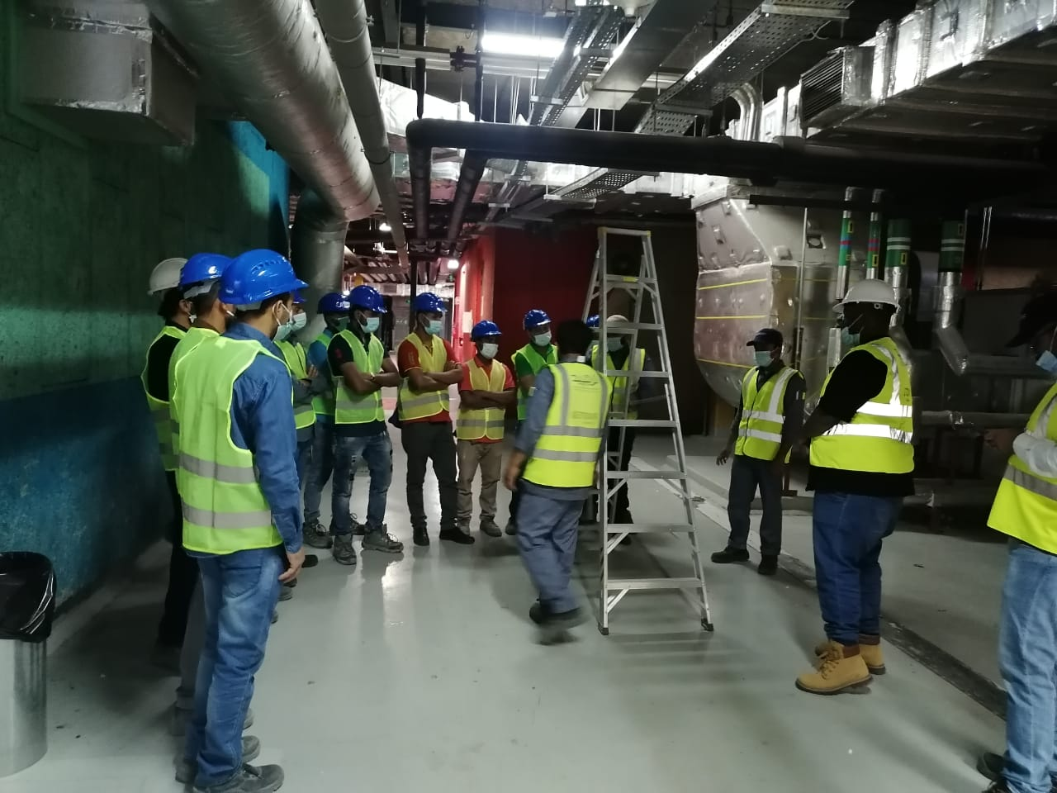

Slide 44
PROJECT NAME: KING ABDUL AZIZ MEDICAL CITY LOCATION: RIYADH CLIENT: ENOVA by Veolia CONSULTANT: TARSHID (NESCO)
Scope Executed:
Temporary office site Energization – Excavation, cable pulling, final Terminations and commissioning
Fencing scope for complete site.

